Slide 1
The Proper Management of Universal Wastes

Slide 2
Universal Waste Rule
EPA's universal waste regulations (finalized in 1996) streamline hazardous waste management standards for federally designated "universal wastes," which include:
Batteries
Pesticides
Mercury-Containing Equipment (added to Rule in 2005)
Fluorescent Bulbs (added to Rule in 1999)
Aerosol Cans (added to the Rule in 2020)

Slide 3
Universal Waste Rule
  Designed to reduce the amount of hazardous waste in regular trash
  Encourage recycling and proper disposal of certain common hazardous wastes
  Reduce the regulatory burden on businesses

Slide 4
The Proper Management of Spent Mercury-Containing Lamps
SPENT MERCURY-CONTAINING LAMPS INCLUDE, BUT ARE NOT LIMITED TO:
1. FLUORESCENT LAMPS, INCLUDING COMPACT FLUORESCENT LAMPS
2. HIGH PRESSURE SODIUM LAMPS
3. MERCURY VAPOR LAMPS
4. METAL HALIDE LAMPS

Slide 5
The Proper Management of Spent Mercury-Containing Lamps
ENVIRONMENTAL AFFAIRS HAS IMPLEMENTED A PROGRAM TO ASSURE THAT THE HANDLING, ACCUMULATION, AND DISPOSAL OF SPENT LAMPS COMPLIES WITH FEDERAL AND STATE RULES.

Slide 6
The Proper Management of Spent Mercury-Containing Lamps
THE FOLLOWING DEPARTMENTS HAVE ASSUMED THE RESPONSIBILITY OF COLLECTING SPENT LAMPS FROM BUILDINGS:
    Facilities
    Housekeeping
    Phyotron
    University Housing
    Student Affairs Maintenance (Talley)
    USDA

Slide 7
The Proper Management of Spent Mercury-Containing Lamps
LAMPS WILL BE STORED IN DESIGNATED AREAS FOR PICK UP BY EHS PERSONNEL. THE DESIGNATED STORAGE LOCATIONS ARE THE LOADING DOCKS AT THE FOLLOWING LOCATIONS:
Watauga
Polk Hall
Biltmore
Textiles
Poe Hall
Williams Hall
Fountain Dining Hall
USDA (Ligon Street)
Daniels Hall
Phytotron
Central Receiving Warehouse
College of Veterinary Medicine
D.H. Hill Library
Talley Student Center
Dearstyne Recycling Center

Slide 8
Spent Mercury-Containing Lamps – Procedures
UNIVERSAL WASTE LAMPS SHOULD BE PLACED INTO CONTAINERS OR PACKAGES THAT ARE STRUCTURALLY SOUND AND WILL PREVENT BREAKAGE.
EACH CONTAINER MUST REMAIN CLOSED UNLESS LAMPS ARE BEING REMOVED OR ADDED TO THE CONTAINER.
EACH CONTAINER MUST BE PROPERLY LABELED AND MARKED WITH THE WORDS (UNIVERSAL WASTE – “NAME OF ITEM”) AND DATED.
ANY BROKEN LAMP OR LAMP THAT SHOWS EVIDENCE OF BREAKAGE MUST BE IMMEDIATELY CLEANED UP, PLACED INTO A CONTAINER LABELED WITH THE WORDS “HAZARDOUS WASTE, BROKEN LAMPS”, AND SUBMITTED FOR PICK UP THROUGH HAZTRAK.

Slide 9
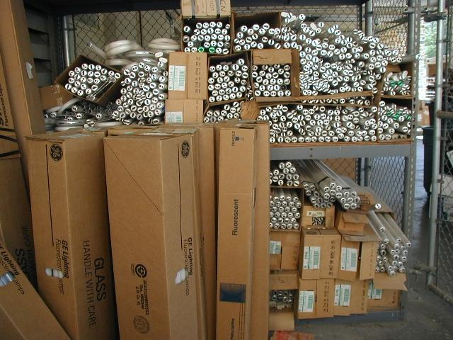
The Proper Management of Spent Mercury-Containing Lamps – Container Label
Improperly Stored Waste Lamps
Open Container – Handle must be taped closed.

Slide 10
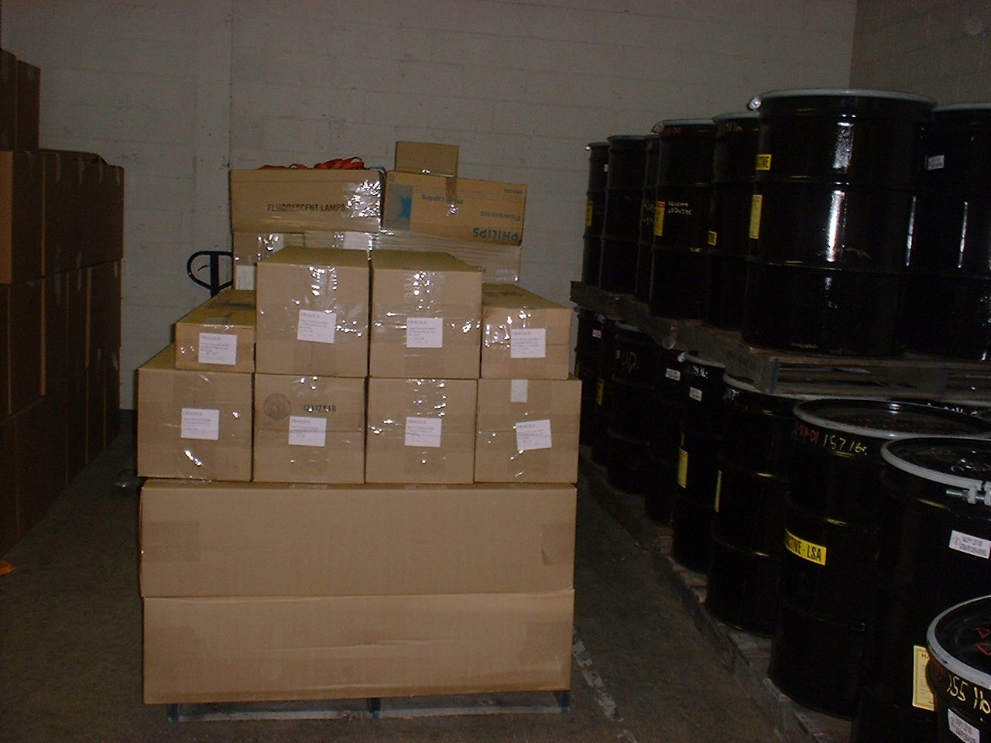
The Proper Management of Spent Mercury-Containing Lamps – Container Label
Properly Stored Waste Lamps
Taped Closed, Labeled, and Dated

Slide 11
The Proper Management of Spent Mercury-Containing Lamps – Container Label
UNIVERSAL WASTE
WASTE LAMPS
ACCUMULATION START DATE____________

Slide 12
The Proper Management of Spent, Unused, or Unwanted Aerosol Cans
Items should be placed into containers that are structurally sound and will prevent breakage or placed in a designated aerosol can collection container.
Each container must remain closed unless items are being removed or added to the container.
Each container or item must be properly labeled and marked with the words (Universal Waste – “Aerosol Can”) and dated.
Any item that shows evidence of leakage must be immediately placed into a separate container and labeled with the words (Waste “Aerosol Can”) and dated.

Slide 13
The Proper Management of Spent, Unused, or Unwanted Aerosol Cans
AEROSOL CANS WILL BE STORED IN DESIGNATED CONTAINERS FOR PICK UP BY EHS PERSONNEL. THE DESIGNATED STORAGE CONTAINERS ARE LOCATED ADJACENT TO THE LOADING DOCKS AT THE FOLLOWING LOCATIONS:
Watauga
Polk Hall
Biltmore
Textiles
Poe Hall
Williams Hall
Fountain Dining Hall
USDA (Ligon Street)
Daniels Hall
Phytotron
Central Receiving Warehouse
College of Veterinary Medicine
D.H. Hill Library
Talley Student Center
Dearstyne Recycling Center
Mail Services
Golf Maintenance Shop

Slide 14
The Proper Management of Spent, Unused, or Unwanted Aerosol Cans
If you generate or accumulate other types of waste material (i.e. biological, chemical, or radiological), aerosol cans can be submitted for pick up via the online waste management tool (EHSA).

Slide 15
The Proper Management of Universal Waste Batteries and Mercury Containing Equipment
Items should be placed into containers that are structurally sound and will prevent breakage.
Each container must remain closed unless items are being removed or added to the container.
Each container or item must be properly labeled and marked with the words (Universal Waste – “Name of Item”) and dated.
Any item that shows evidence of leakage must be immediately placed into a separate container and labeled with the words (Waste “Name of Item”) and dated.

Slide 16
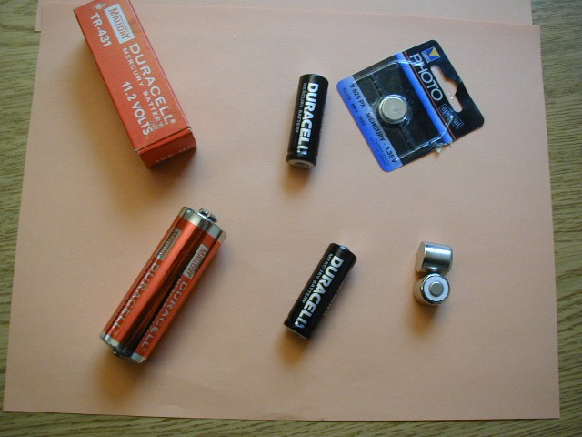
Types of Universal Waste Mercury Batteries

Slide 17
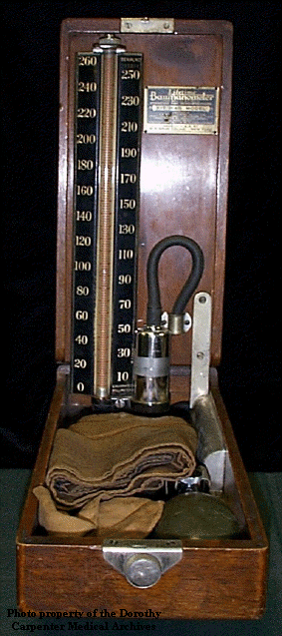
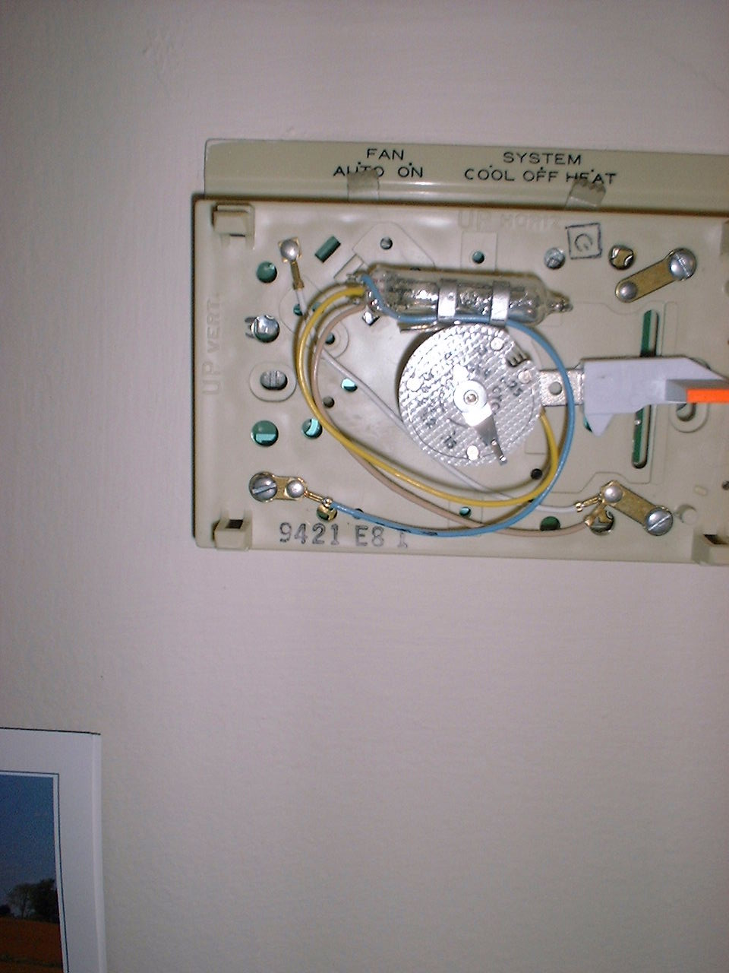
Types of Mercury-Contaminated Equipment

Slide 18
Notes
Universal wastes can not be stored for more than 10 months prior to pick up by EHS personnel for disposal.
    The waste can either be submitted via EHSA for disposal or placed in a designated pickup location for that material.
    If the waste is not dated, inspectors assume it has been there for more than the allotted time and can issue violations.

